Slide 1
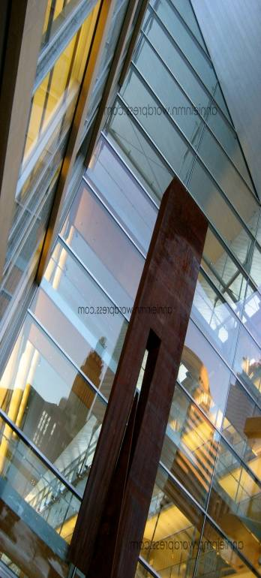
Libraries in the 21st Century
Dale Vidmar Professor/ Information Literacy and Instruction Librarian Education, Communication, and Health, Physical Education, & Leadership Librarian
Southern Oregon University
Ashland, Oregon, Lions Club
October 28, 2014

Slide 2
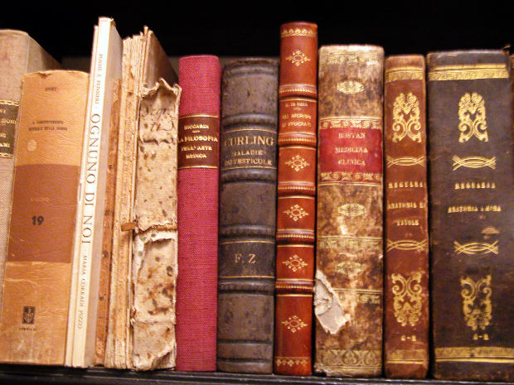
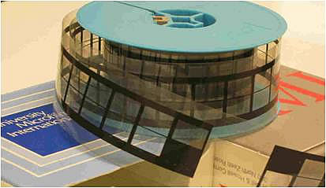
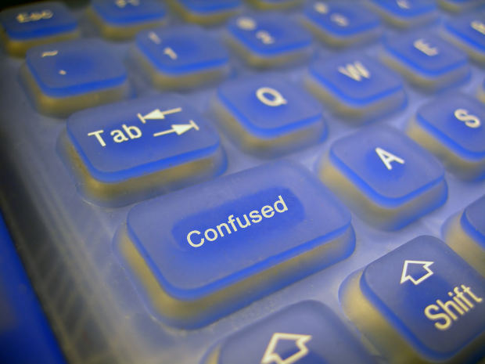
What is a Library?
Books
Microfilm
Help!

Slide 3
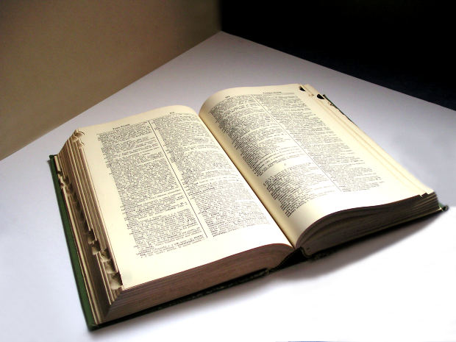
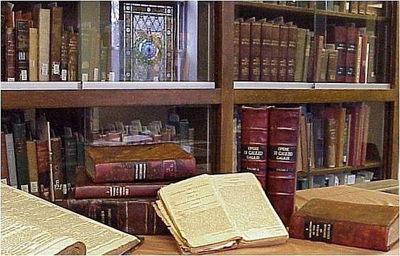
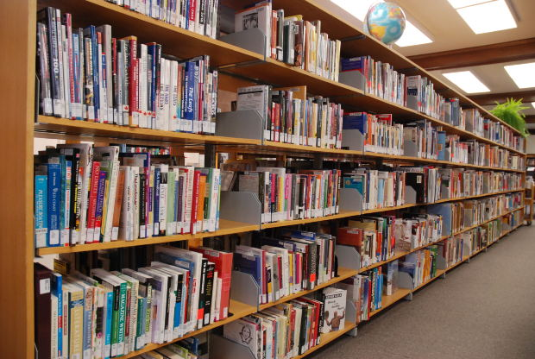
What is a Library?
. . . and more books

Slide 4
What is a Library?
. . . but books are just written words on a page

Slide 5
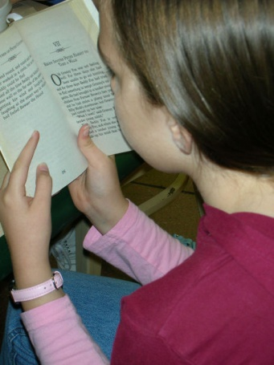
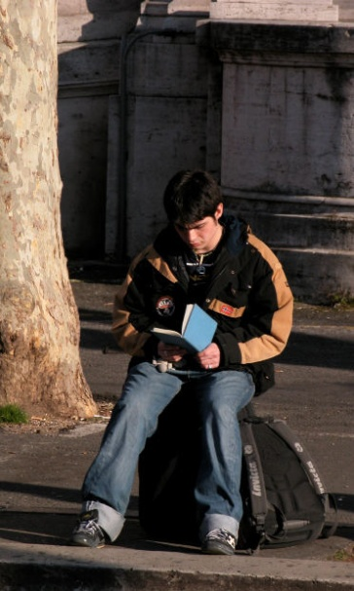
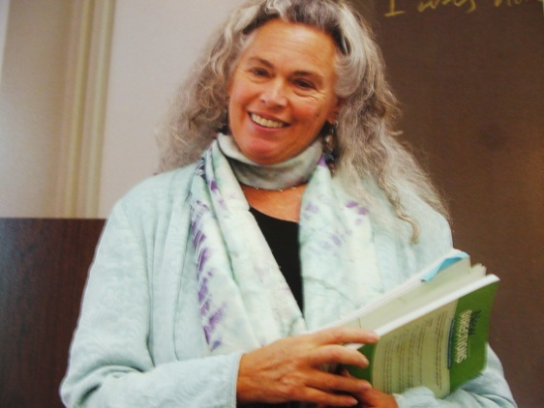
What is a Library?
Books are books.
Books become something more only when they are connected to people!

Slide 6
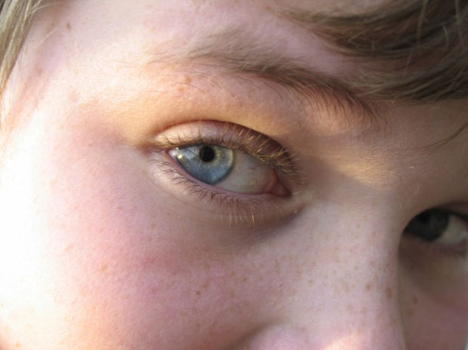
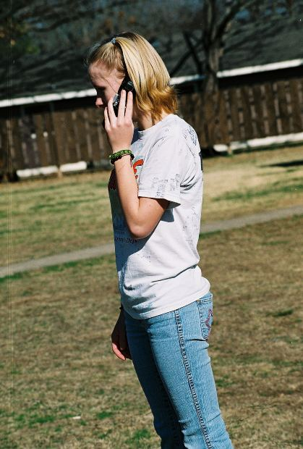
What is a Library?
Libraries are about connections and community!

Slide 7
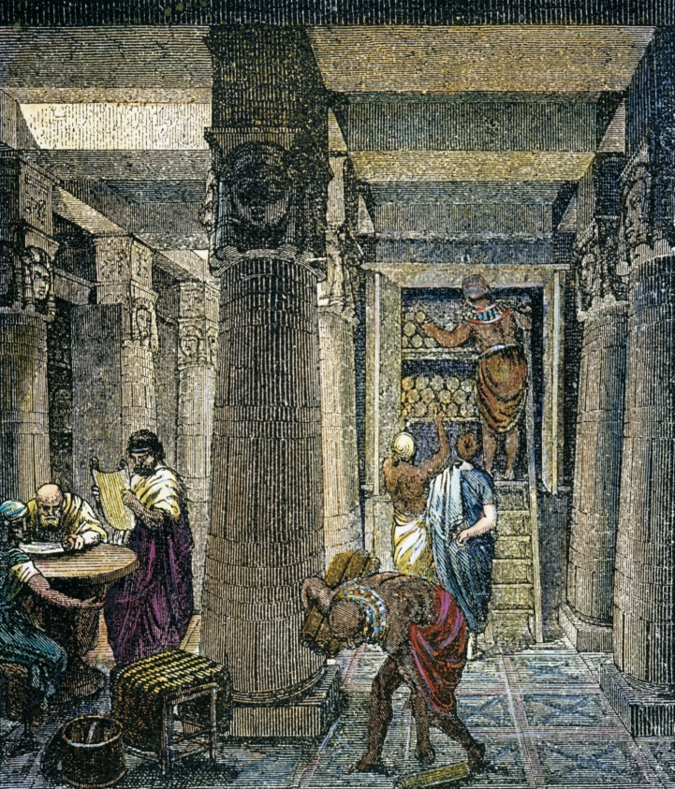
Ancient Library of Alexandria
Intellectual capital of the world
Museum
Academy
Research Center
Library
Housed scholars from all cultures . . . and their families

Slide 8
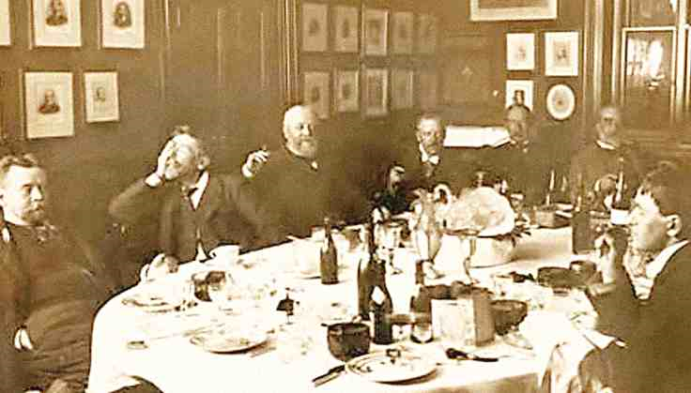
Early Libraries in America
Social Libraries (1731- Ben Franklin) - join by subscription
Library Company (1742) - join by buying stock in the library
Essentially, book collections and social club for wealthy men!

Slide 9
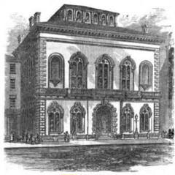
Early Libraries in America
Public Libraries (1854) – Boston Public Library
Future of democracy depends on educated citizens
Link between knowledge and thinking
Free access to materials owned by the community

Slide 10
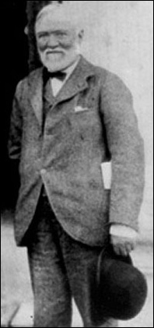
Early Libraries in America
Carnegie Libraries
Spent over $56 million
Created 2,509 libraries between 1883 and 1929
1,689 new libraries built in the United States
Libraries gave people the opportunity to improve themselves
Andrew Carnegie

Slide 11
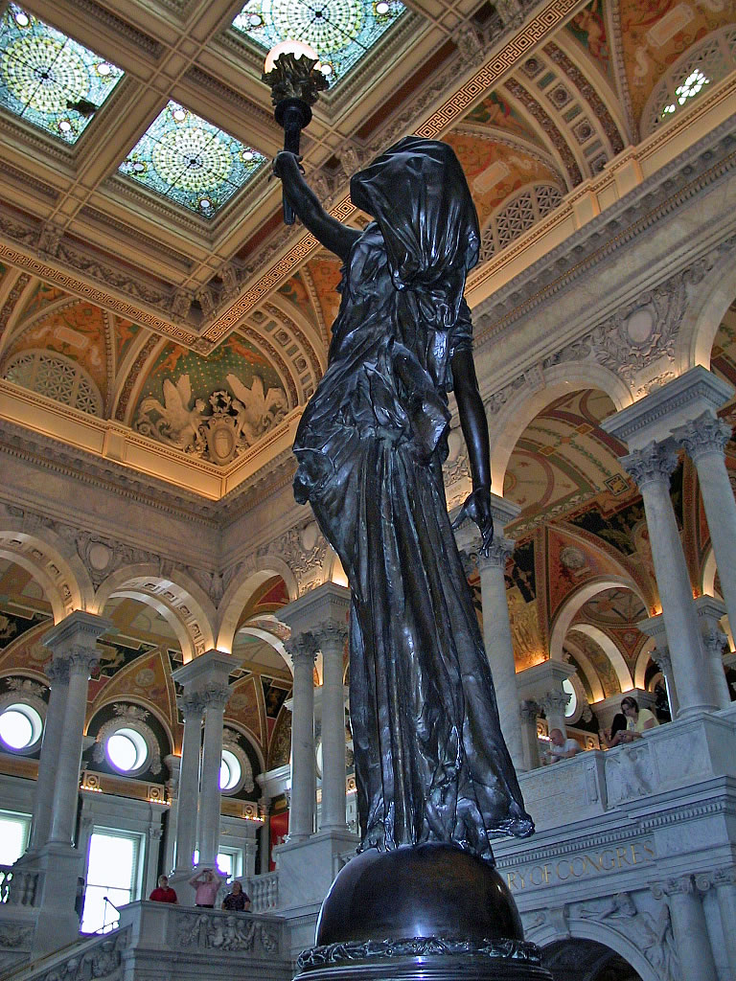
Early Libraries in America
Libraries are “essential to the functioning of a democratic society . . . and libraries are the great “tools of scholarship, great repositories of culture, and great symbols of the freedom of the world.”
Franklin D. Roosevelt (June 1941)

Slide 12
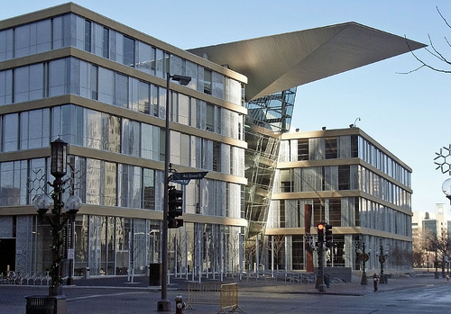
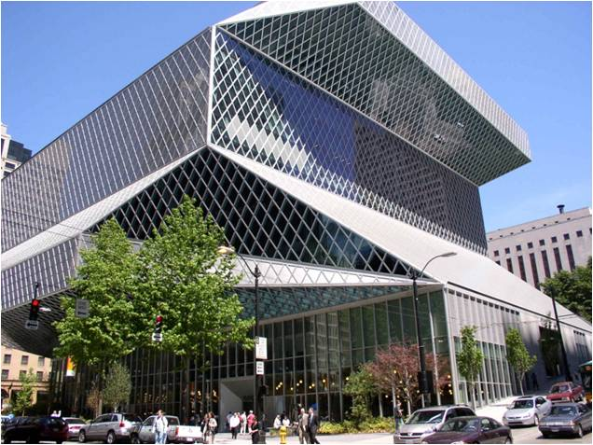
Do we really need costly library buildings located in the heart of the cities, schools, and universities?

Slide 13
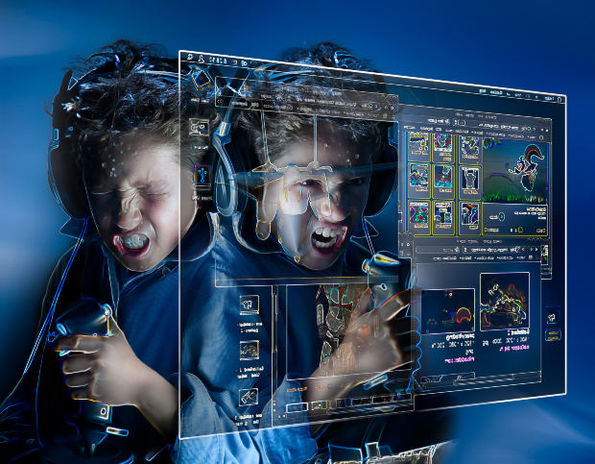
If so, what purpose do libraries serve?
Can’t we just get everything we need online?

Slide 14
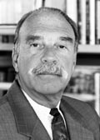
“You simply don’t have to build a traditional library these days. . . .”
Barry Munitz
California State University Chancellor
on why the new Cal State University Monterey Bay would have a “virtual” not a physical library.
“Wiring the Ivory Tower”
Newsweek : January 30, 1995

Slide 15
Today, the 136,000 sq. ft. CSU Monterey Bay Library houses more than 163,000 print and 17,000 electronic books.

Slide 16
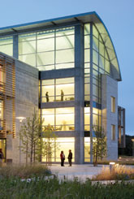
The CSUMB Library also accesses more than 50,000 electronic journals, magazines, and newspapers . . .
and features an atrium, information literacy center, writing center, study rooms, café, and auditoriums.

Slide 17
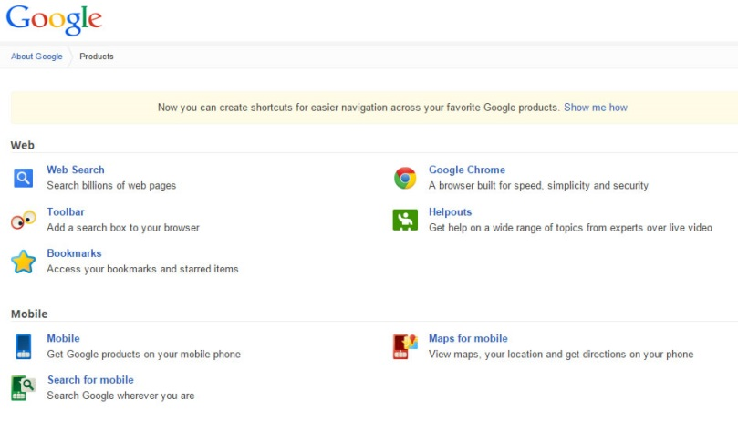
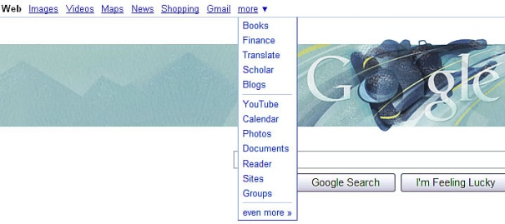
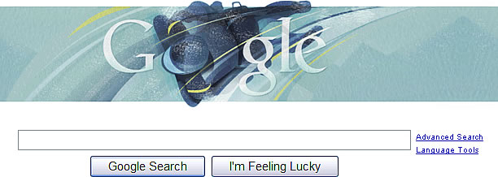
Googleopolis
Everything is Coming Up Google!
“Why is Google so easy and the library so hard?”
Carol Tenopir
“Visualize the Perfect Search?
Library Journal
3/1/2009

Slide 18
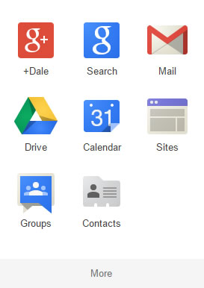
Googleopolis
Unfortunately, not everything is on Google!
Google began as a search tool to locate information in its database. Simplicity and ease were the keys to success.

Slide 19
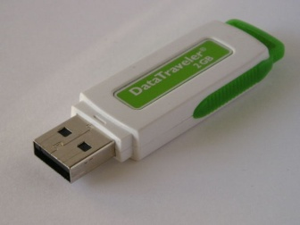
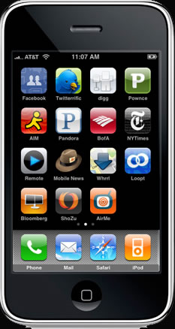
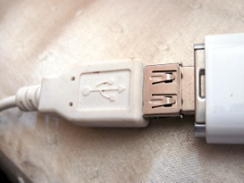
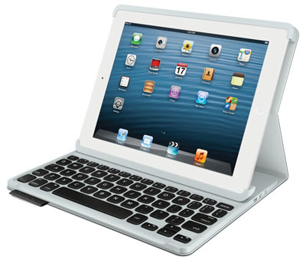
New Generation of Library Users
Changing expectations
Grew up with technology
24/7 access
Multi-formats
Interactive
Interdependent
Instant gratification
Personalized service
Digital natives

Slide 20
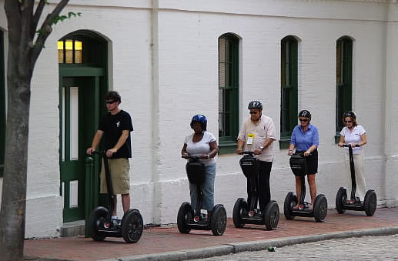
This new generation will determine the future of libraries!

Slide 21
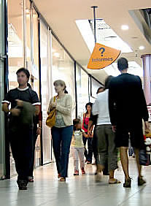
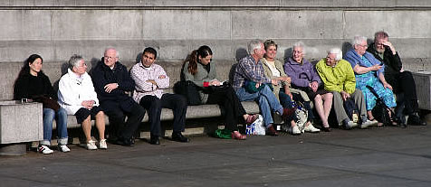
Challenges
Varied Constituencies
Different individuals want different services
Everyone wants everything!
Everyone wants everything “Now!”
From anywhere!
At any time!
At no expense!

Slide 22
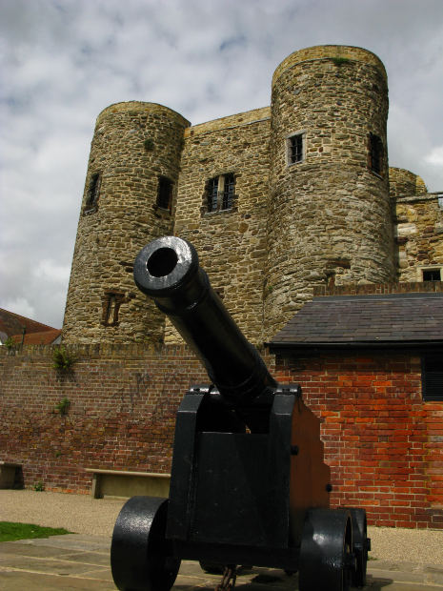
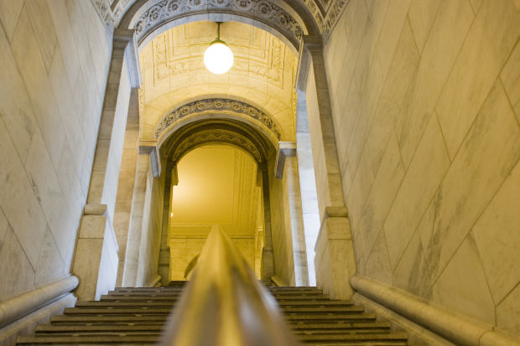
Challenges
Tradition
No longer about hallowed halls!

Slide 23
Challenges
Wireless and Beyond
Blogs
Computers
Changing Technologies
Ipads, Iphones, I Yi Yi Yi!
Mashups
Wikis
Virtual Realities
Web 2.0 to Who Knows

Slide 24
Librarians of Tomorrow
Go beyond love for books and people
Create and connect content – in particular digital content
Create relationships – patrons and users will be individuals and clients
Virtual and face-to-face presence
Information literacy will lead to transliteracy
Flexibility is a virtue
Tomorrow began yesterday

Slide 25
Librarians Interfacing with the Future
5 Principles > 10 Words
Be Present
Pay Attention
Listen Deeply
Speak Truthfully
Act Creatively
Robert Rabbin 5 Principles of Authentic Living

Slide 26
So What Will Become of the Library in the 21st Century?
We will live in a hyper society that is will demand more, better, faster, whenever, wherever, with no strings attached!

Slide 27
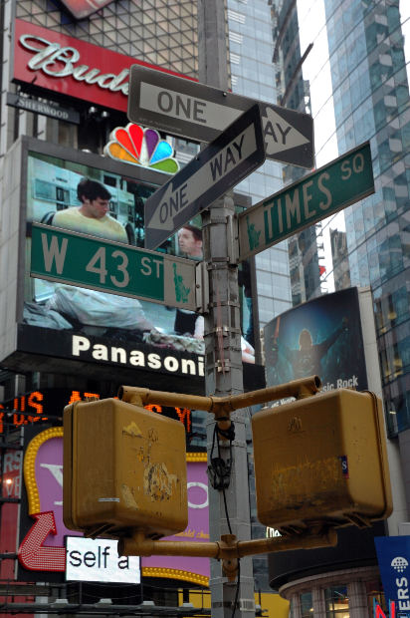
So What Will Become of the Library in the 21st Century?
Libraries will provide instruction, service, guidance, and more sophisticated access to information.

Slide 28
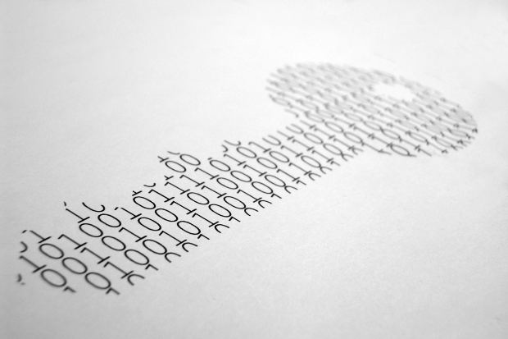
So What Will Become of the Library in the 21st Century?
Technology, like books, is only technology.
Technology only breathes life into our world when it connects people and ideas.

Slide 29
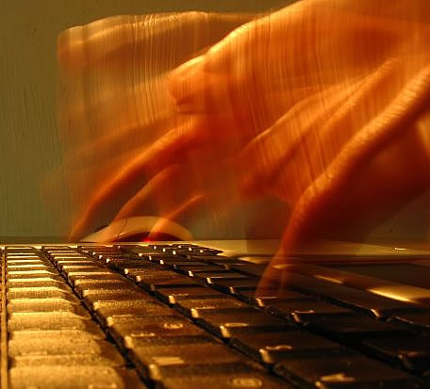
So What Will Become of the Library in the 21st Century?
Libraries will continue to organize and house information, but funding will be more directed toward access not collection.

Slide 30
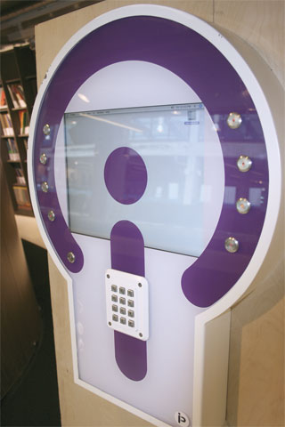
So What Will Become of the Library in the 21st Century?
Libraries will continue to organize and house information, but funding will be more directed toward access not collection.
Tank U free digital download station
Delft Public Library
From the Marketing Library Services

Slide 31
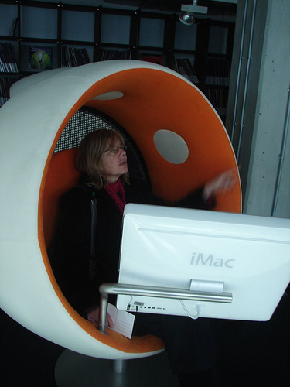
So What Will Become of the Library in the 21st Century?
Connectivity will transform libraries not to buildings without wall, but place beyond form.
Tank U free digital download station
Delft Public Library
From the Marketing Library Services

Slide 32
So What Will Become of the Library in the 21st Century?
Change and transformation will be the dominant principle, and libraries will be defined by how they respond to possibilities.

Slide 33
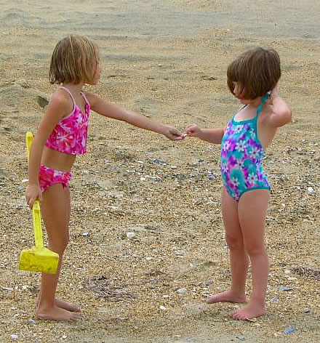
So What Will Become of the Library in the 21st Century?
Libraries will become more consortial and interdependent to solve financial constraints.

Slide 34
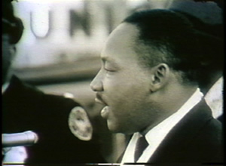
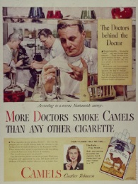
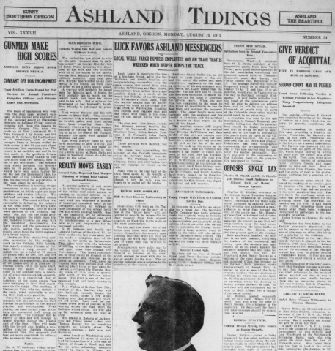
So What Will Become of the Library in the 21st Century?
Digital Collections will be prevalent and the norm!
Civil Rights Digital Library
University of Georgia
Legacy Tobacco Documents Library
University of California, San Francisco
Historic Oregon Newspapers
University of Oregon

Slide 35
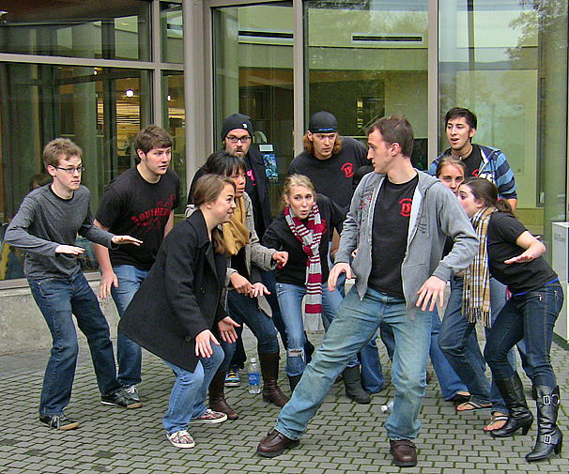
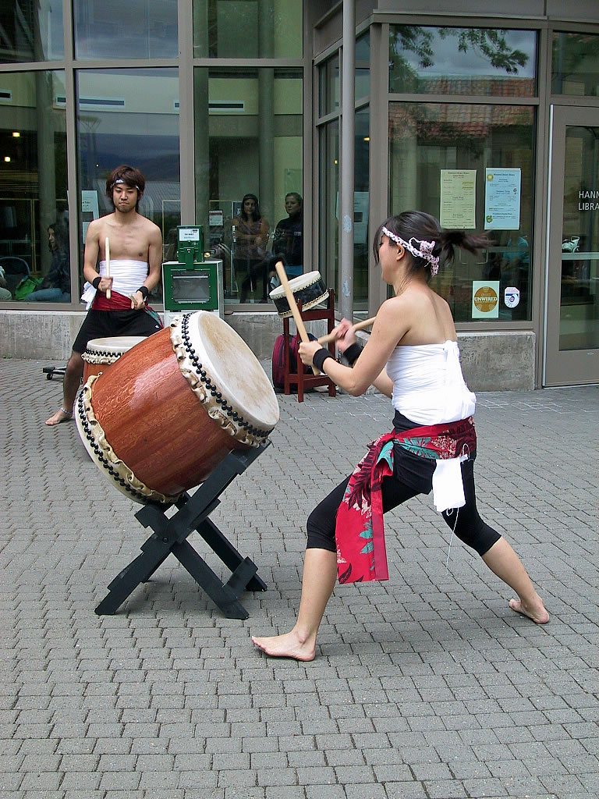
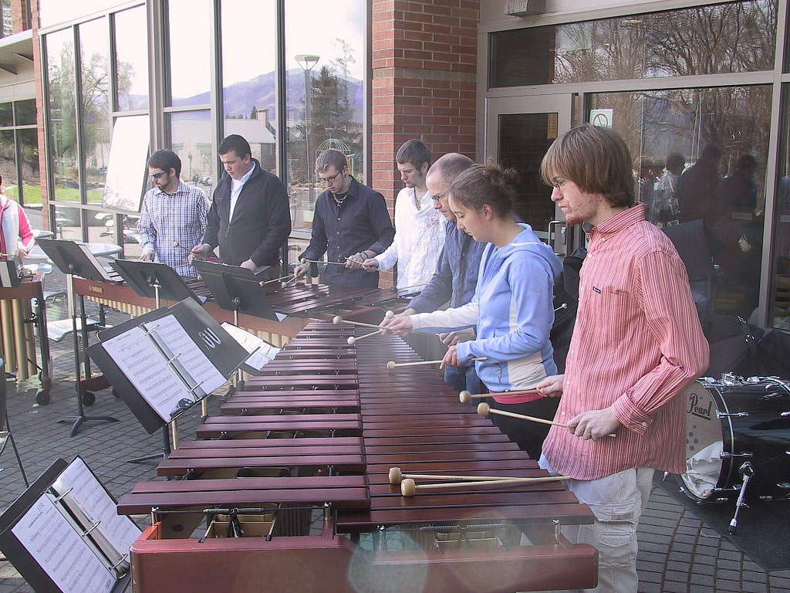
No More Shssss!
Libraries as Place

Slide 36
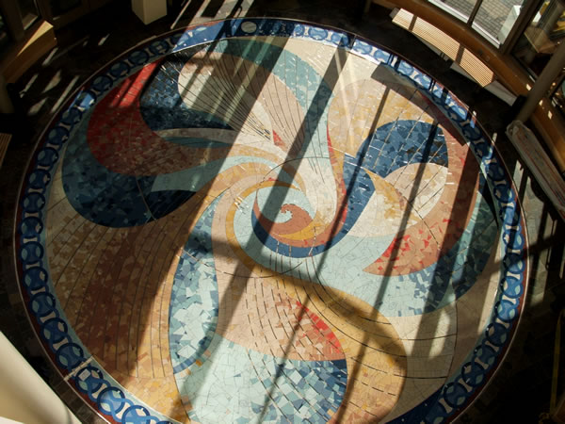
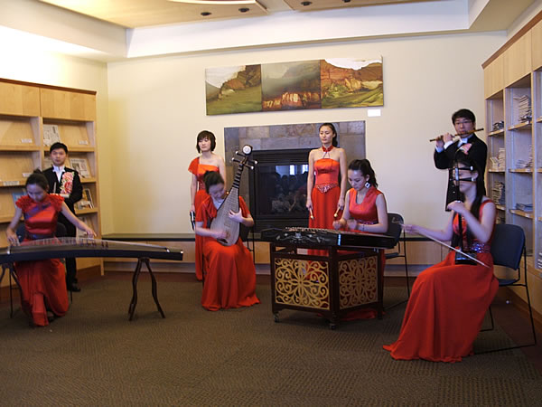
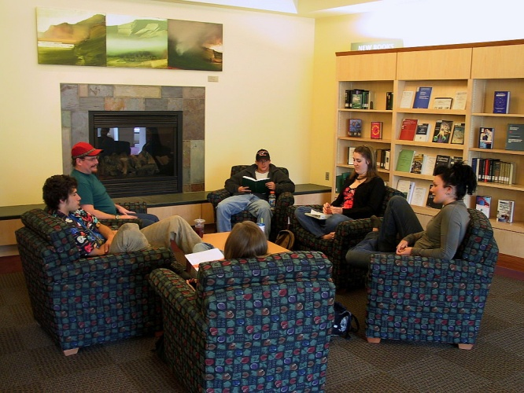
Library as a Place
Cultural Center
Art
Social gatherings
Cultural events

Slide 37
Library as a Place
Learning Center

Slide 38
Where is the life we have lost in living?
Where is the wisdom
we have lost in knowledge?
Where is the knowledge
we have lost in information?
T.S. Eliot
Choruses from the Rock

Slide 39
The future of libraries in the 21st century will be determined by their communities.
Each individual, every voice, every choice will create the future.

Slide 40
What will you say about tomorrow, today?

Slide 41
Libraries in the 21st Century
Dale Vidmar Information Literacy and Instruction Coordinator/ Education, Communication, and Health, Physical Education, & Leadership Librarian
Southern Oregon University
Ashland, Oregon, Lions Club
October 28, 2014
http://webpages.sou.edu/~vidmar/libraries/lions.pptx

